Slide 1
Cyber Security with Linux Summer Training 2025
Good morning, everyone!
Welcome to the Cyber Security with Linux training!
I’m Mohit Tiwari, and over the next 5 weeks, we’re going to learn not just what cyber security is, but how it really works — through tools, terminal, test attacks, and team projects.
This is not a ‘notes-and-quiz’ course. This is a hands-on, full-experience lab-style training where you’ll install, break, build, and defend.
If you’re ready to learn by doing — you’re in the right place.

Slide 2
Meet Your Trainer – Mohit Tiwari
Assistant Professor, Department of Computer Science & Engineering, BVCOE Delhi
25+ Years of Experience in Software Development, Networking, System Administration & Cybersecurity
Former Industry Professional – Led Infrastructure & Security Projects in Banking, Education & Enterprise IT
IEEE Senior Member | Member – ACM, CSI | Fellow member of many international societies
Author of Books on Cybersecurity & Engineering Management
Patents/Copyrights/Trademarks Holder | Active Researcher in Cloud Security, AI, and Digital Infrastructure
Invited Speaker & Resource Person at National and International Conferences, FDPs & Workshops
Mentor for student Projects, Startups & Student Innovation Teams
Honoured with multiple awards for excellence in cybersecurity education and academic leadership
Recognized by academic institutions and peer forums for contributions to technical training and digital transformation
Featured as a mentor and panelist in national innovation initiatives
Before entering academia, I spent several years working in the software and IT industry — managing Linux servers, configuring firewalls, deploying enterprise networks, and supporting critical infrastructure across sectors like finance, education, and business services. I’ve handled outages at odd hours, watched real-time malware attacks, set up secure VPN tunnels across continents, and mitigated phishing attempts on live mail servers. Everything I teach — I’ve truly experienced.
With over 25 years of combined industry and academic experience, I bring to this training a unique blend of practical insight, technical depth, and research-driven clarity. My mission is to bridge the gap between classroom learning and real-world applications.
This training reflects that mission. It’s not just about slides or notes — it’s about preparing you to think like a cybersecurity professional, break and secure systems, analyze real threats, and build solutions. You'll learn by doing, and I’ll be with you at every step of the way.
Welcome to this training — where stories become skills, and concepts become careers.

Slide 3
Why This Training Stands Out – Year After Year
Led by Mohit Tiwari – IEEE Senior Member | Cybersecurity | Linux | Cloud | Real-World Mentor
“This training turns beginners into confident explorers of cybersecurity tools and systems.”
“Every year, we see students from this batch perform exceptionally in projects, internships, and external competitions.”
“I came in with zero Linux experience. Left with enough skill to run my own VM setup and explain Kali tools to others.”
“This was the only summer course where I didn’t just take notes — I built something. And it felt like I actually learned.”
“One of our most dependable, application-driven trainings — the feedback speaks for itself.”
“Before this course, I had never used Linux. After it, I was writing scripts and scanning networks.”
“This is the only course where we didn’t just copy-paste — we actually experimented.”
“Every summer, this is the most applied, impactful training in the department.”
Past participants have:
• Cracked ethical hacking internships
• Built their own penetration testing toolkits
• Published cybersecurity blogs & GitHub projects
• Gained confidence in real-world terminal & OS skills
Before we dive into today’s session, let me tell you why this course continues year after year. It’s because of students like you — who come in curious and leave confident. Over the years, I’ve trained hundreds of learners across many batches, and each time the feedback is the same: students think more clearly, solve more creatively, and use tools more fearlessly. These testimonials are real — just anonymized for privacy. From beginners running their own VMs to students publishing blogs and tools, this training has shaped many journeys.
So… let’s make your story the next one.

Slide 4
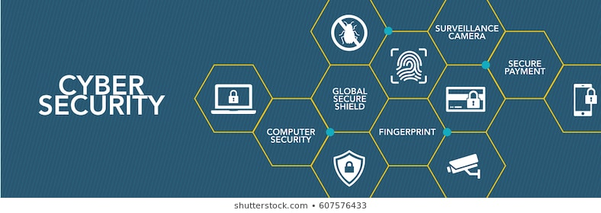


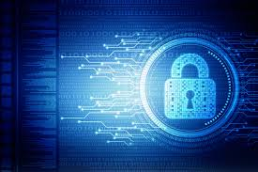

Slide 5
Introduction to cyber security tools and cyber attack
Cybersecurity roles, processes and operating system security
Cybersecurity compliance, Framework and system administration
Network security and Database
(Beginners level)

Slide 6
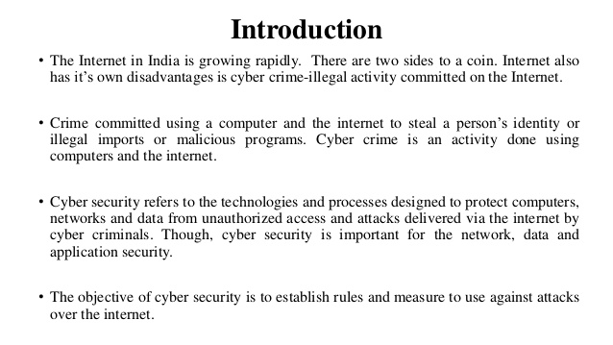

Slide 7
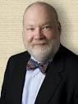
Importance of Cyber Security
“The only system which is truly secure is one which is switched off and unplugged, locked in a titanium safe, buried in a concrete bunker, and is surrounded by nerve gas and very highly paid armed guards. Even then, I wouldn’t stake my life on it.”
- Professor Gene Spafford
https://spaf.cerias.purdue.edu/
In security matters:
There is nothing like absolute security
We are only trying to build comfort levels, because security costs money and lack of it costs much more
Comfort level is a manifestation of efforts as well as a realization of their
effectiveness & limitations

Slide 8
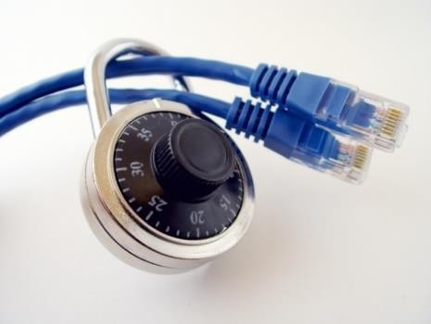
Growing Importance of Cyber Security
The Internet allows an attacker to work from anywhere on the planet.
Risks caused by poor security knowledge and practice:
Identity Theft
Monetary Theft
Legal Ramifications (for yourself and your organization)
Sanctions or termination if policies are not followed
According to the SANS Institute, the top vectors for vulnerabilities available to a cyber criminal are:
Web Browser
IM Clients
Web Applications
 Excessive User Rights

Slide 9
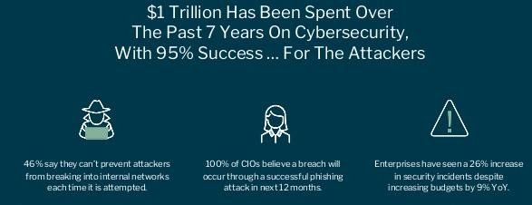
Cyber Security
Cyber security refers to the body of technologies, processes, and practices designed to protect networks, devices, programs, and data from attack, damage, or unauthorized access.

Slide 10
Cybersecurity Is THIS 👇
Let’s not memorize definitions. Let’s talk about the AIIMS ransomware attack or Cosmos Bank breach. Cybersecurity is what stands between you and disaster.

Slide 11
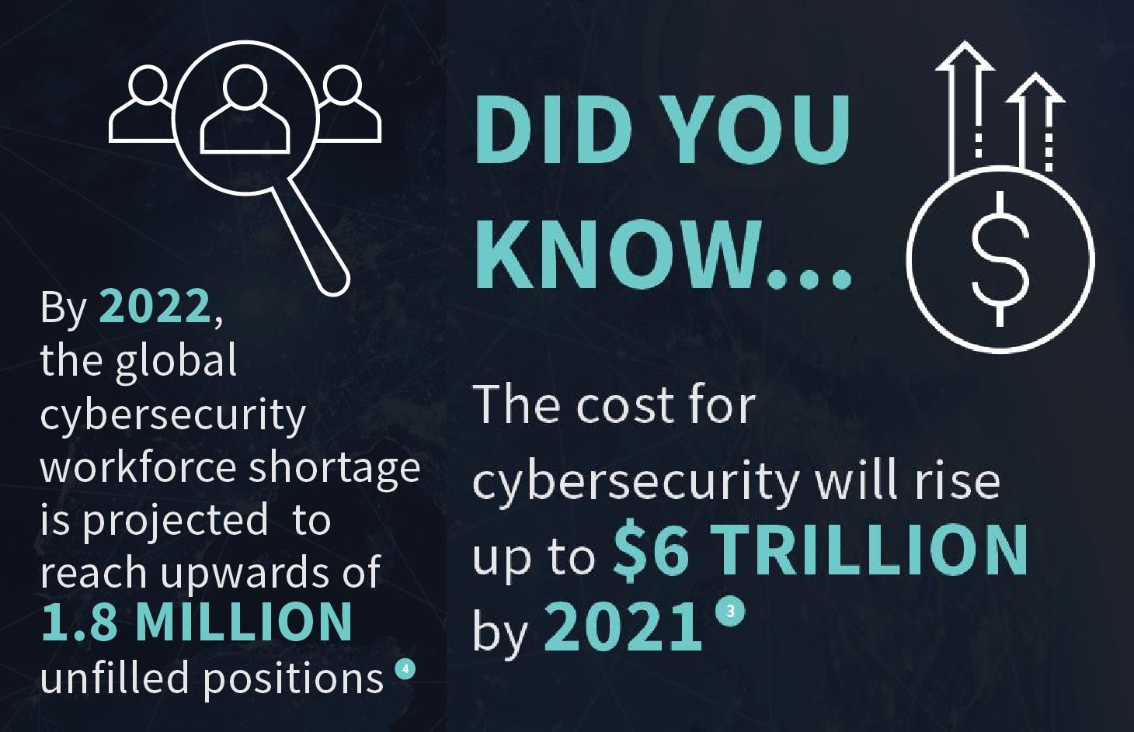
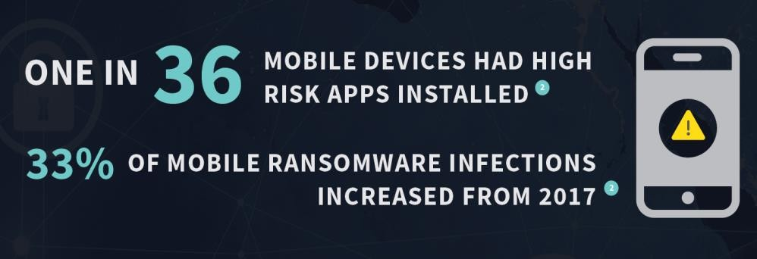
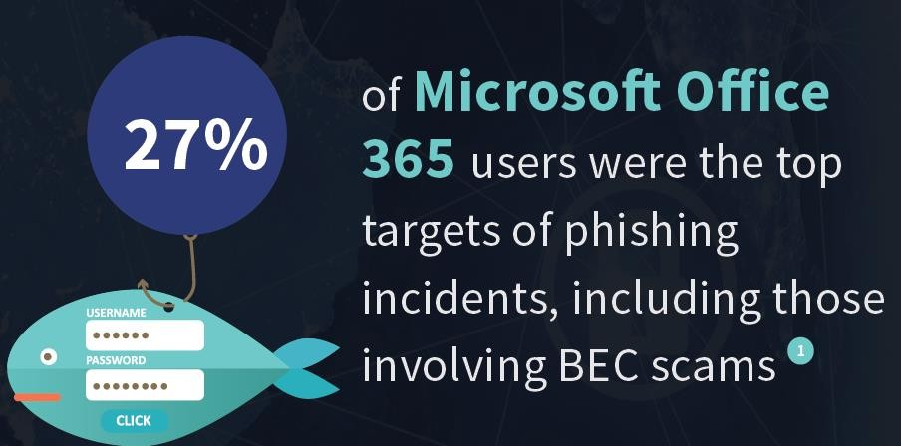

Cyber Security
https://www.varonis.com/blog/data-breach-statistics/

Slide 12

Cyber Security is Safety
Security: We must protect our computers and data in the same way that we secure the doors to our homes.
Safety: We must behave in ways that protect us against risks and threats that come with technology.

Slide 13
Storytime – Printer Sending Data to China
During a network audit at a client office, we found unusual traffic at night — a printer was making outbound connections. It was a malware infection pushing scanned data to an IP in China. A printer! That’s why even IoT needs strong network segmentation.

Slide 14
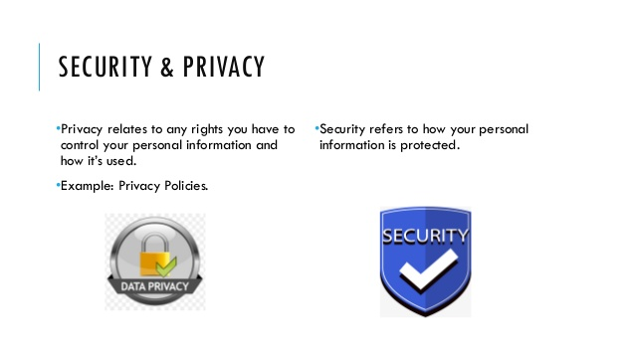

Slide 15
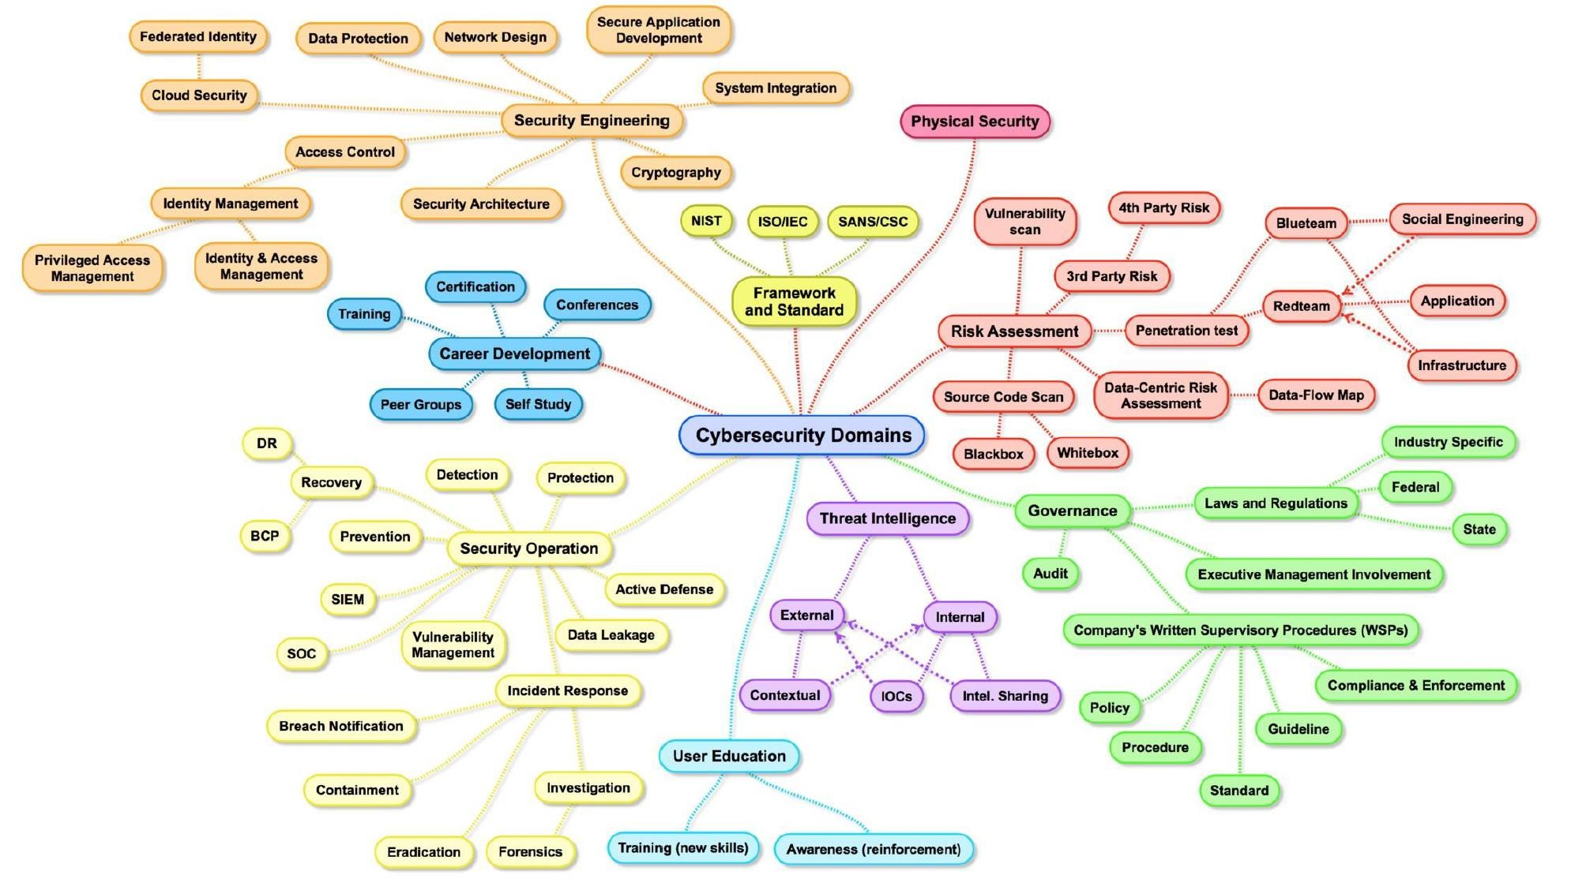
Cyber Security Domains

Slide 16
Want a ₹10 Lakh Job? Know These Domains
Here’s a real job post from Naukri.com — for a Security Analyst role at an MNC in Bangalore.It asks for hands-on experience in SIEM, threat intelligence, Linux environments, log monitoring, and incident response.These are not PhD-level expectations — they’re learnable, and this training gives you the foundation.So yes, ₹10 LPA is absolutely realistic — but only if you know what domains matter.

Slide 17
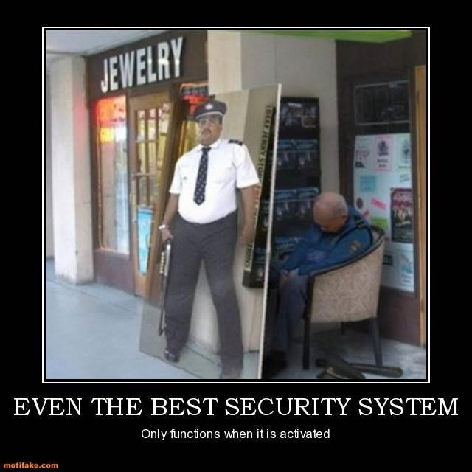
False Sense of Security?

Slide 18
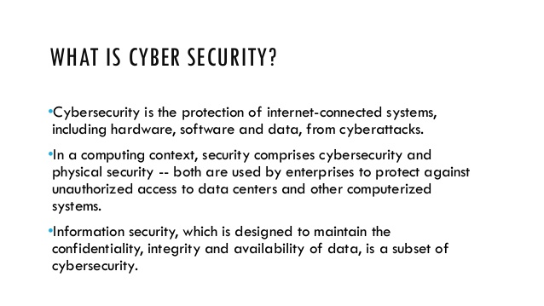

Slide 19
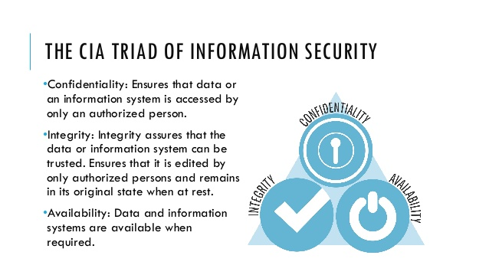

Slide 20
CIA Triad
Confidentiality
Example:
Criminal steals
customers’ usernames, passwords, or credit card information
Protecting information from unauthorized access and disclosure

Slide 21
What If Your Cloud Drive Got Corrupted?
What if you suddenly lose access to your Google Drive? That's not a confidentiality problem, it’s an availability issue. What if someone edits your file? That’s an integrity breach. This slide explains CIA using daily Indian tech usage.

Slide 22
CIA Triad
Integrity
Protecting information from unauthorized modification
Example:
Someone alters payroll information or a proposed product design

Slide 23
CIA Triad
Availability
Example:
Your customers are unable to access your online services
Preventing disruption in how information is accessed

Slide 24
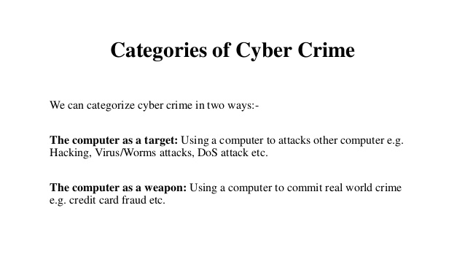

Slide 25
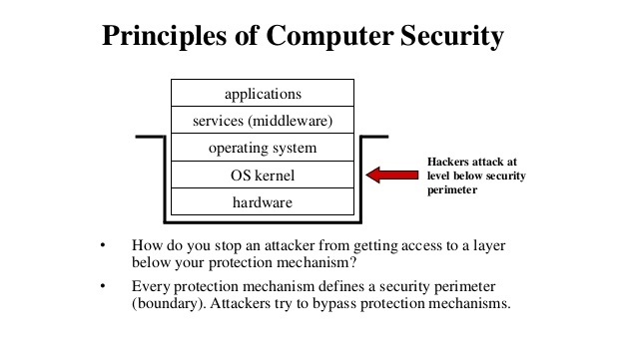

Slide 26
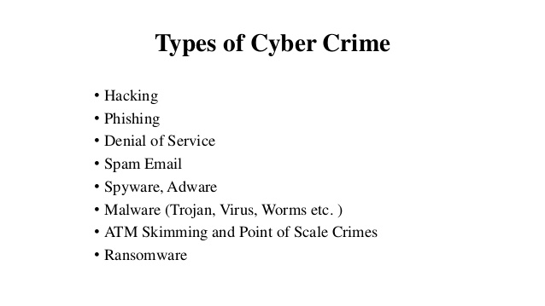

Slide 27
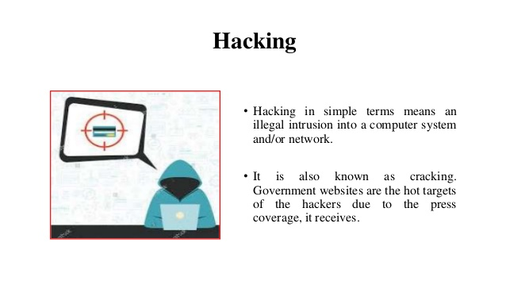

Slide 28
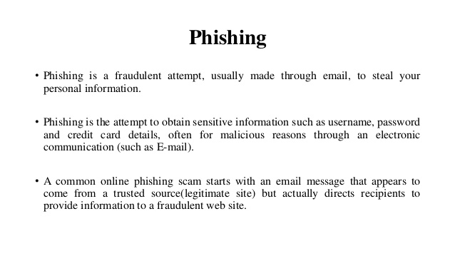

Slide 29
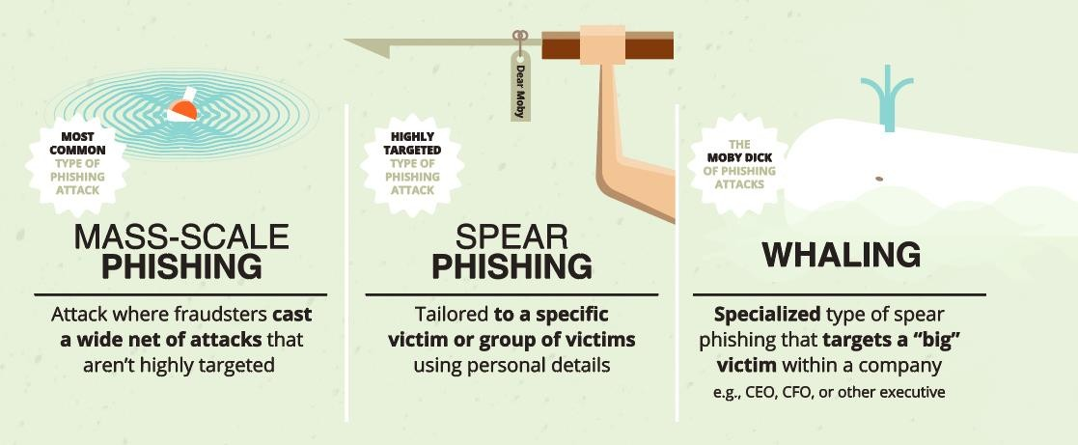
Phishing
◆ Phishing refers to the practice of creating fake emails or SMS that appear to come from someone you trust, such as: Bank, Credit Card Company, Popular Websites
◆ The email/SMS will ask you to “confirm your account details or your vendor’s account details”, and then direct you to a website that looks just like the real website, but whose sole purpose is for steal information.
◆ Of course, if you enter your information, a cybercriminal could use it to steal your identity and possible make fraudulent purchases with your money.

Slide 30
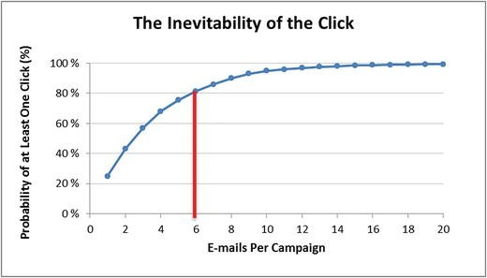
Phishing Statistics
◆ Verizon DBIR 2020: Phishing is the biggest cyber threat for SMBs, accounting for 30% of SMB breaches
◆ KnowBe4: 37.9% of Untrained Users Fail Phishing Tests
◆ 84% of SMBs are targeted by Phishing attacks
◆ A new Phishing site launches every 20 seconds
◆ 74% of all Phishing websites use HTTPS
◆ 94% of Malware is delivered via email

Slide 31
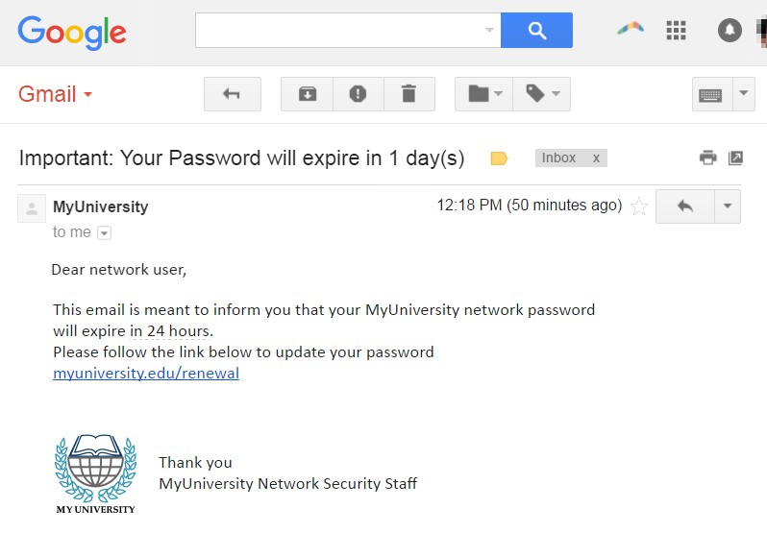
Example of Phishing

Slide 32
Quick Poll – Which is Most Dangerous?
Which cyber attack worries you the most?
Ransomware,
Phishing,
Data Breach.
This small poll will reveal your instincts. Are you worried about privacy loss, system lockouts, or stolen money? You'll soon learn how to defend against each.

Slide 33
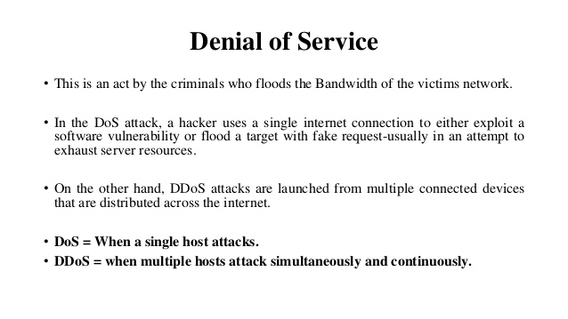

Slide 34
Storytime – College Result PDF Was Tampered
A case from another university: students claimed the uploaded result PDFs were incorrect. Turns out, someone had downloaded the original file, modified it, and re-uploaded it using admin credentials. That’s why digital signatures and audit logs matter.

Slide 35
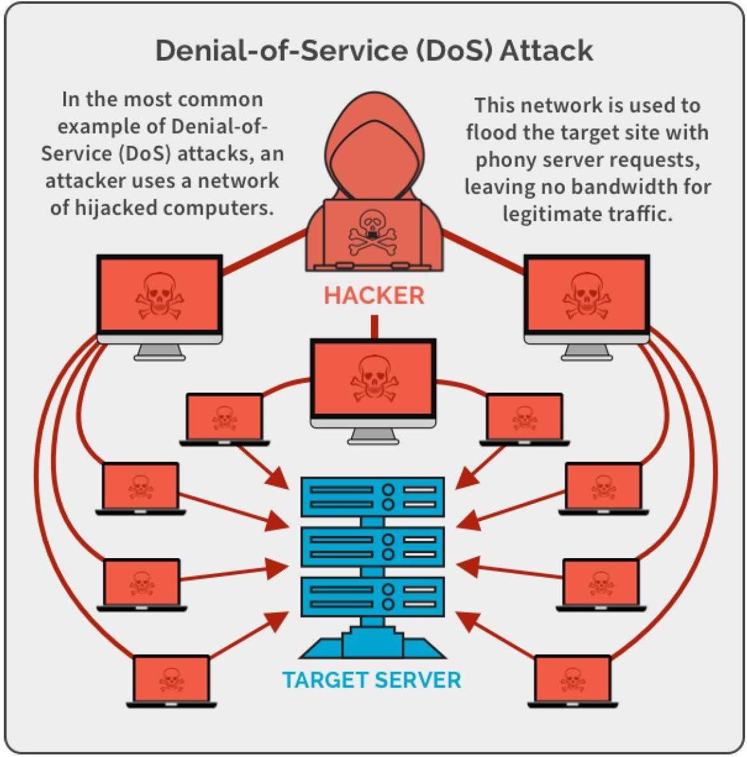
Denial of Service Attack

Slide 36
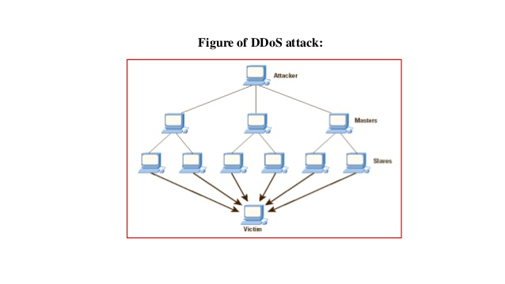

Slide 37
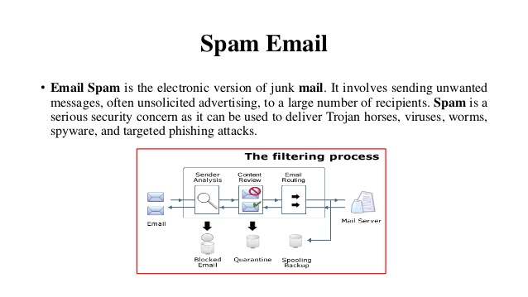

Slide 38
Business/Official Email Compromise
◆ BEC is a big problem for you and your organization:
◆ Your email is compromised.
◆ Another employee of your organization is compromised
◆ Almost always, these emails fall into 2 categories:
Downloading and spreading additional malware automatically
Urging the customer to perform a financial transaction immediately
◆ Tips and Tricks to share with customers:
◆ BEC made up half of cyber-crime losses in 2019; $75K per scam
◆ Standard phishing email awareness – don’t click links or download attachments
◆ Pay attention to the email address
◆ Enable MFA for business email accounts

Slide 39
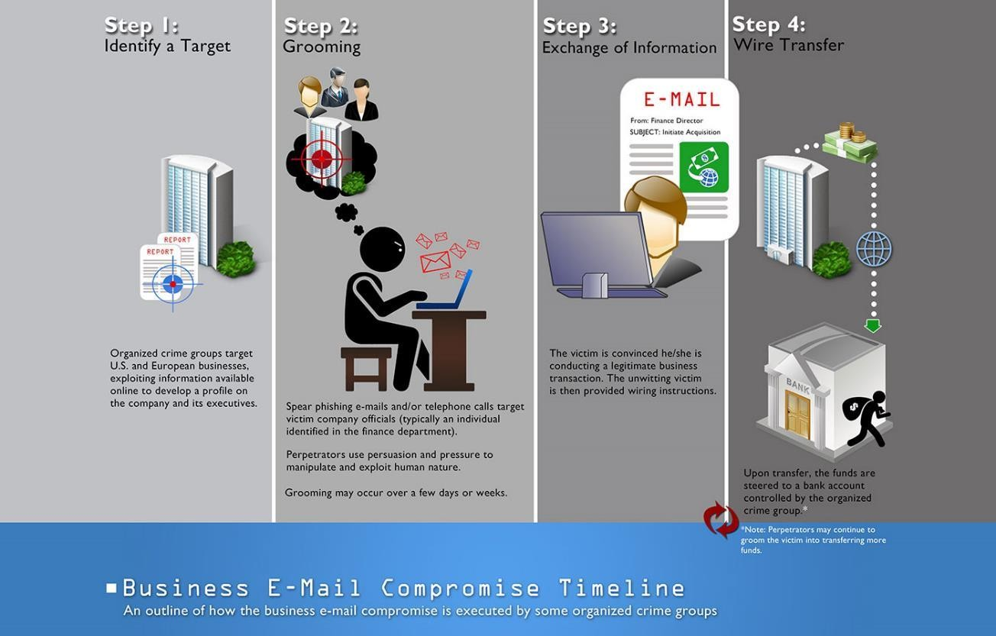
Business Email Compromise -2

Slide 40
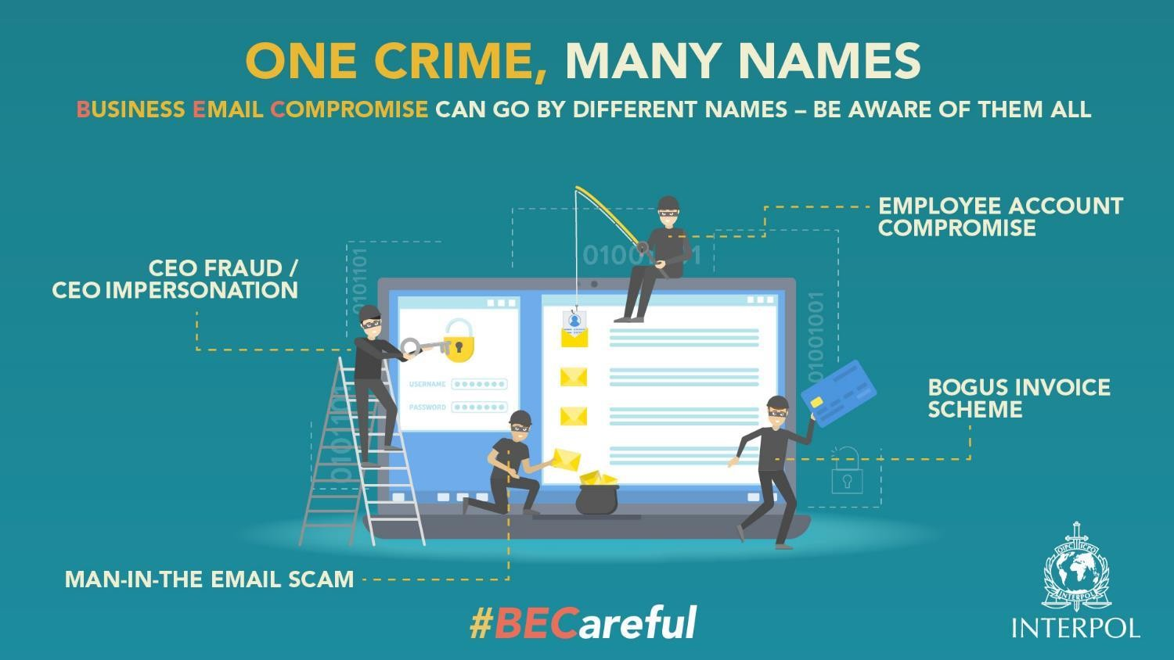
Business Email Compromise - 3

Slide 41
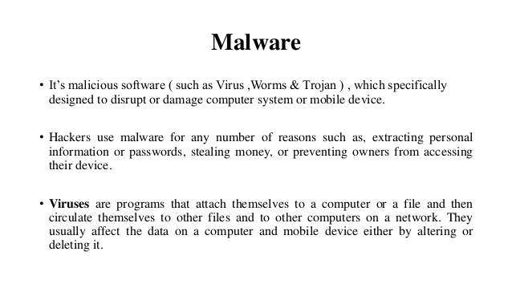

Slide 42
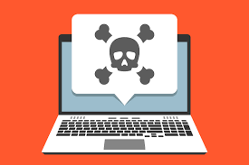
Malware
◆ Malware = “malicious software”
◆ Malware is any kind of unwanted software that is installed without your consent on your computer and other digital devices.
◆ Viruses, Worms, Trojan horses, Bombs, Spyware, Adware, Ransomware are subgroups of malware.

Slide 43
Social Engineering
◆ When attempting to steal information or a person’s identity, a hacker will often try to trick you into giving out sensitive information rather than breaking into your computer.
◆ Social Engineering can happen:
◆ Over the phone
◆ By text message
◆ Instant message
◆ Email

Slide 44
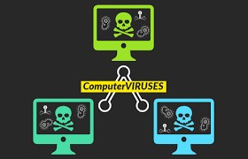
Viruses
◆ A virus tries to infect a carrier, which in turn relies on the carrier to spread the virus around.
◆ A computer virus is a program that can replicate itself and spread from one computer to another.

Slide 45
Viruses cont.
◆ Direct infection: virus can infect files every time a user opens that specific infected program, document or file.
◆ Fast Infection: is when a virus infects any file that is accessed by the program that is infected.
◆ Slow infection: is when the virus infects any new or modified program, file or document.
◆ Great way to trick a antivirus program!
◆ Sparse Infection: is the process of randomly infecting files, etc. on the computer.
◆ RAM-resident infection: is when the infection buries
itself in your Computer’s Random Access Memory.

Slide 46
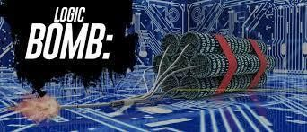
Bombs
◆ Logic Bombs: is programming code that is designed to execute or explode when a certain condition is reached.
◆ Most the time it goes off when a certain time is reached or a program fails to execute.But it these bombs wait for a triggered event to happen.
◆ Most common use of this is in the financial/business world.
◆ Most IT employees call this the disgruntled employee syndrome.

Slide 47
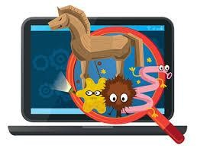
Trojans
◆ Trojan horse: is a program or software designed to look like a useful or legitimate file.
◆ Once the program is installed and opened it steals information or deletes data.
◆ Trojan horses compared to other types of malware is that it usually runs only once and then is done functioning.
◆ Some create back-door effects
◆ Another distribution of Trojans is by infecting a server that hosts websites.
◆ Downfall of Trojans: very reliant on the user.

Slide 48
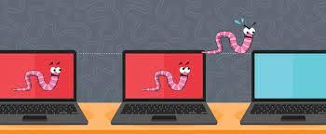
Worms
◆ Worms and viruses get interchanged commonly in the media.
◆ In reality a worm is more dangerous than a virus.
◆ User Propagation vs. Self Propagation
◆ Worm is designed to replicate itself and disperse
throughout the user’s network.
◆ Email Worms and Internet Worms are the two most common worm.

Slide 49
Storytime – Locked Myself Out of a Server
Once, I was hardening an SSH config on a live server. I disabled password auth and forgot to add my SSH public key — locked myself out completely. Had to call someone on-site to reboot into rescue mode. Lesson? Always double-check your access before enforcing security.

Slide 50
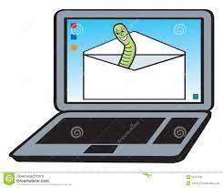
Email Worm
◆ Email worm goes into a user’s contact/address book
and chooses every user in that contact list.
◆ It then copies itself and puts itself into an attachment; then the user will open the attachment and the process will start over again!
◆ Example: I LOVE YOU WORM

Slide 51
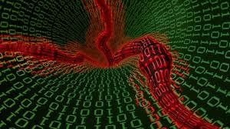
Internet Worms
◆ An Internet Worm is designed to be conspicuous to the user.
◆ The worms scans the computer for open internet ports that the worm can download itself into the computer.
◆ Once inside the computer the worms scans the internet to infect more computers.

Slide 52
Storytime – Recovered Data in a Train
While traveling, I got a panic call from a colleague: non-booting system, client deadline next morning. Used a live Linux USB from my bag, mounted the partition on /mnt, and copied the files — all this in a train compartment. Real skills matter.

Slide 53
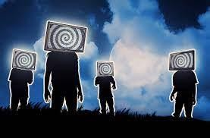
Zombie & Botnet
◆ Secretly takes over another networked computer by exploiting software flows
◆ Builds the compromised computers into a zombie network or botnet
a collection of compromised machines running programs, usually referred to as worms, Trojan horses, or backdoors, under a common command and control infrastructure.
◆ Uses it to indirectly launch attacks
E.g., DDoS, phishing, spamming, cracking

Slide 54
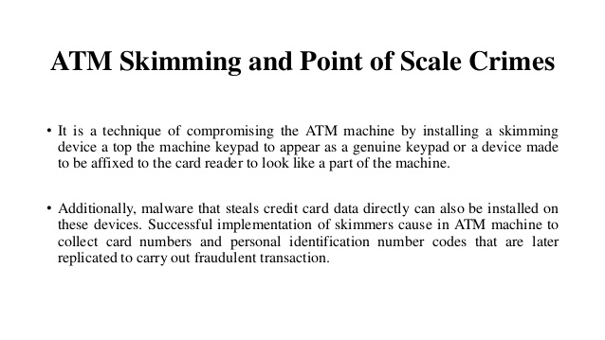

Slide 55
Adware and Spyware
◆ Adware is a type of malware designed to display advertisements in the user’s software.
◆ They can be designed to be harmless or harmful; the adware gathers information on what the user searches the World Wide Web for.
◆ With this gathered information it displays ads corresponding to information collected.
◆ Spyware is like adware it spies on the user to see what information it can collect off the user’s computer to display pop ads on the user’s computer.
◆ Spyware unlike adware likes to use memory from programs running in the background of the computer to keep close watch on the user.
◆ This most often clogs up the computer causing the program or computer to slow down and become un-functional.

Slide 56
Storytime – Port Unknown During Project Review
During final year project review, one student made a login system but didn’t know what port it was running on — nor if it was open to the internet. Security starts with knowing what you expose. Port awareness is basic — and critical.

Slide 57
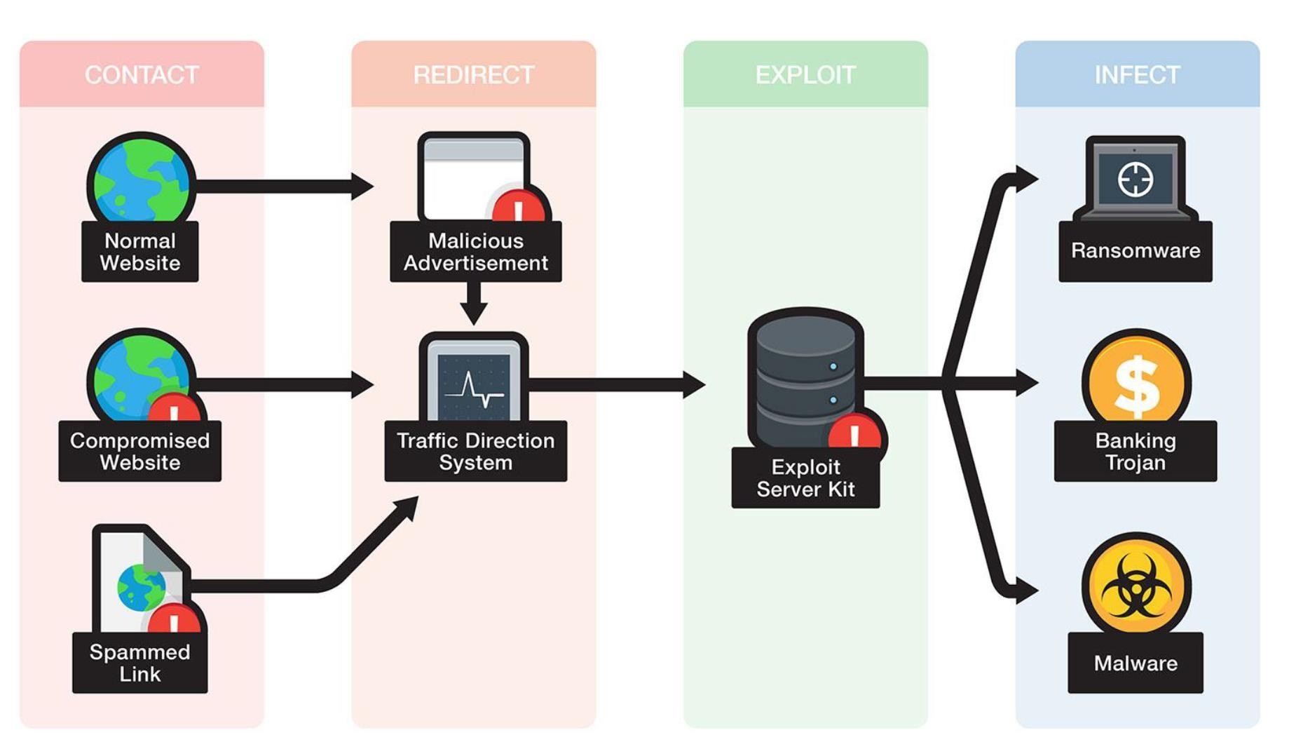
Exploit Kit

Slide 58

Identity Theft
◆ Identity Theft
◆ Impersonation by private information
Thief can ‘become’ the victim
◆ Reported incidents rising
◆ Methods of stealing information
◆ Shoulder surfing
◆ Snagging
◆ Dumpster diving
◆ Social engineering
◆ High-tech methods

Slide 59
Identity Theft
◆ Loss of privacy
◆ Personal information is stored electronically
Purchases are stored in a database
Data is sold to other companies
Public records on the Internet
◆ Internet use is monitored and logged
◆ None of these techniques are illegal

Slide 60
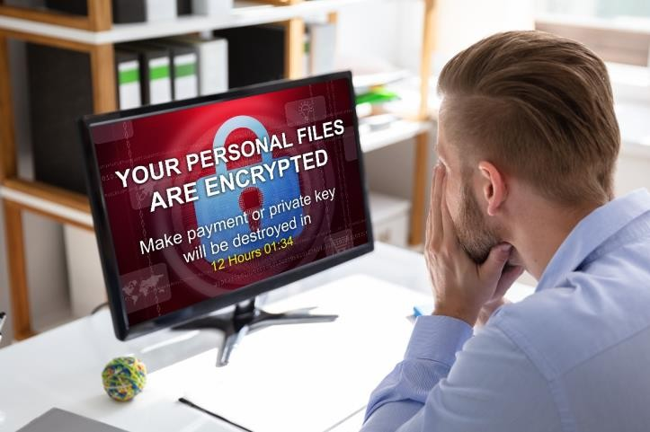
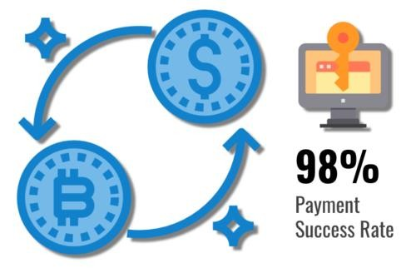
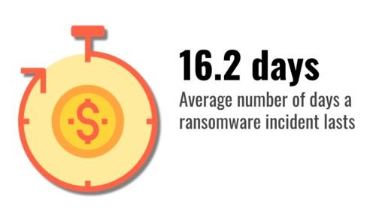
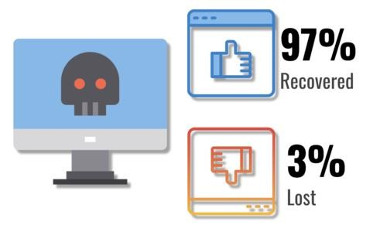
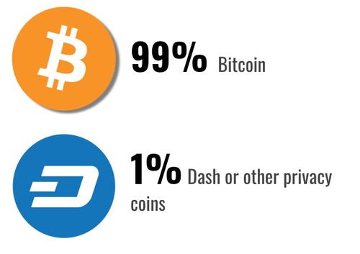
Ransomware
◆ Ransomware is a type of malware that restricts your access to systems and files, typically by encryption and then demands a ransom to restore access.
◆ Often, systems are infected by ransomware through a link in a malicious email. When the user clicks the link, the ransomware is downloaded to the user’s computer, smartphone or other device. Ransomware may spread through connected networks.

Slide 61
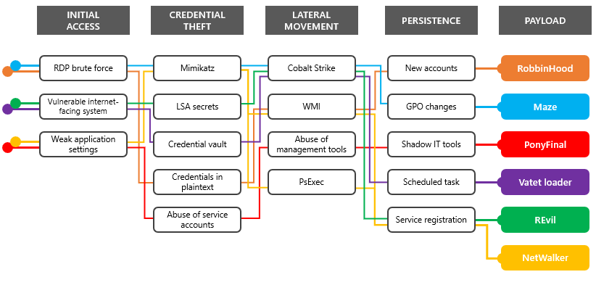
Ransomware - 2
Top Ransomware Vulnerabilities:
RDP or Virtual Desktop endpoints without MFA
Citrix ADC systems affected by CVE-2019-19781
Pulse Secure VPN systems affected by CVE-2019-11510
Microsoft SharePoint servers affected by CVE-2019-0604
Microsoft Exchange servers affected by CVE-2020-0688
Zoho ManageEngine systems affected by CVE-2020-10189
https://www.microsoft.com/security/blog/2020/04/28/ransomware-groups-continue-to-target-healthcare- critical-services-heres-how-to-reduce-risk/

Slide 62

Ransomware Controls
◆ Weapons-Grade Data Backups
◆ Religious Patch Management
◆ Plan to Fail Well (Incident Response Plan)
◆ Know who to call!
◆ Training and Testing Your People
◆ Don’t Open that Email Link/Attachment

Slide 63
If Your Wi-Fi Was Hacked — What Now?
If your hostel Wi-Fi gets hacked, how would you know? What’s your first step? Think like a defender. This is how SOC teams work.

Slide 64
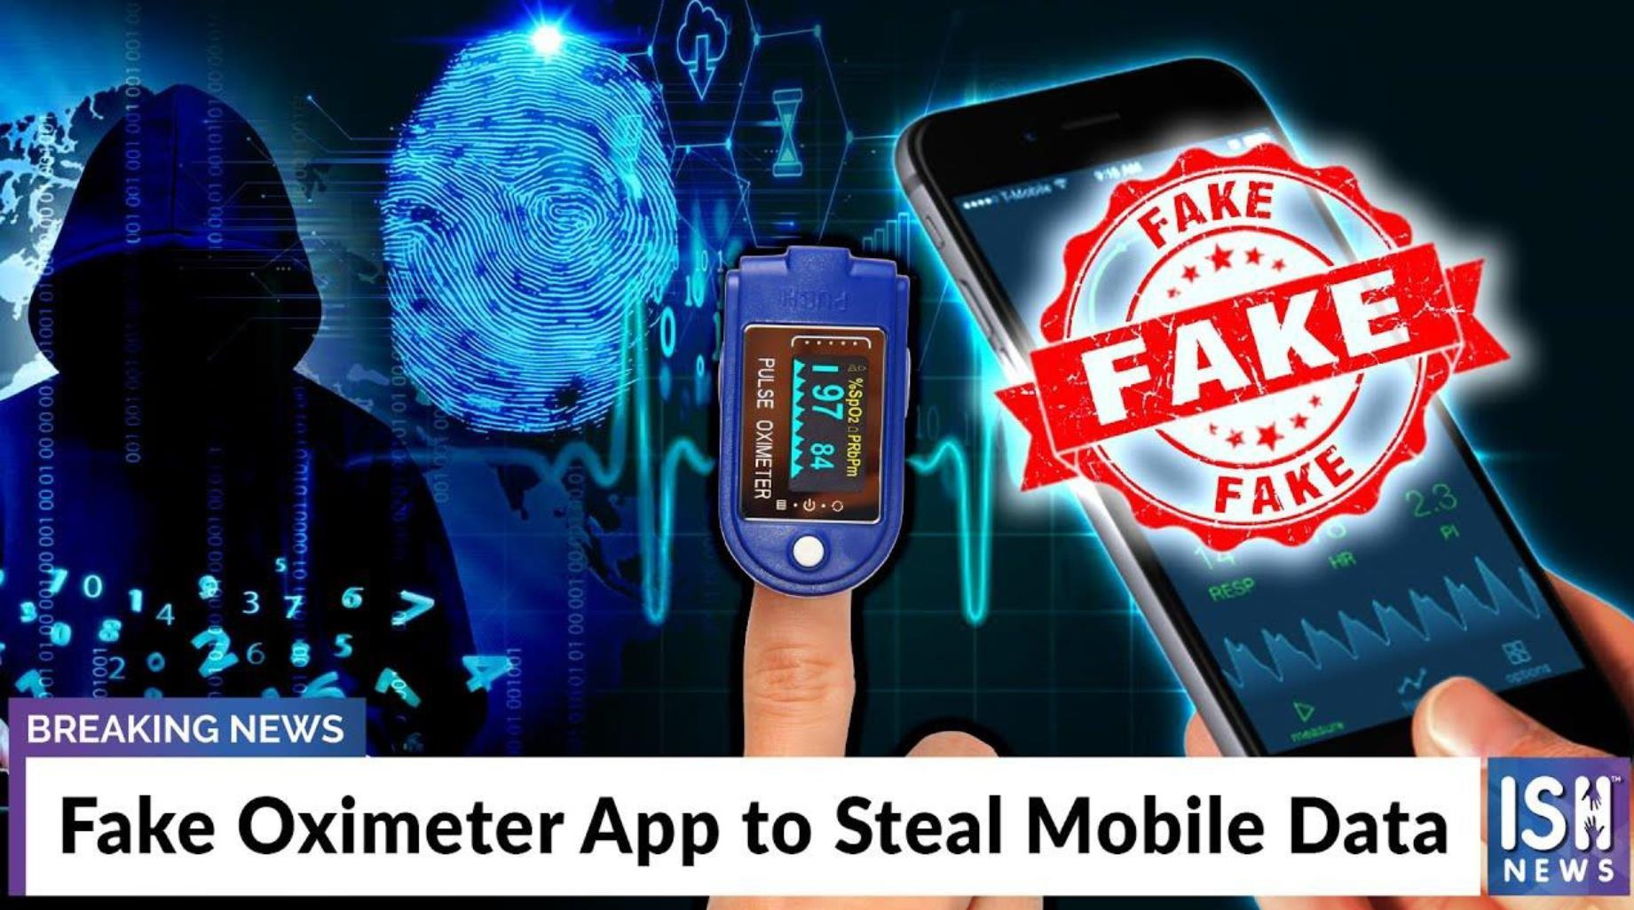
COVID-19 Cyber Threats

Slide 65
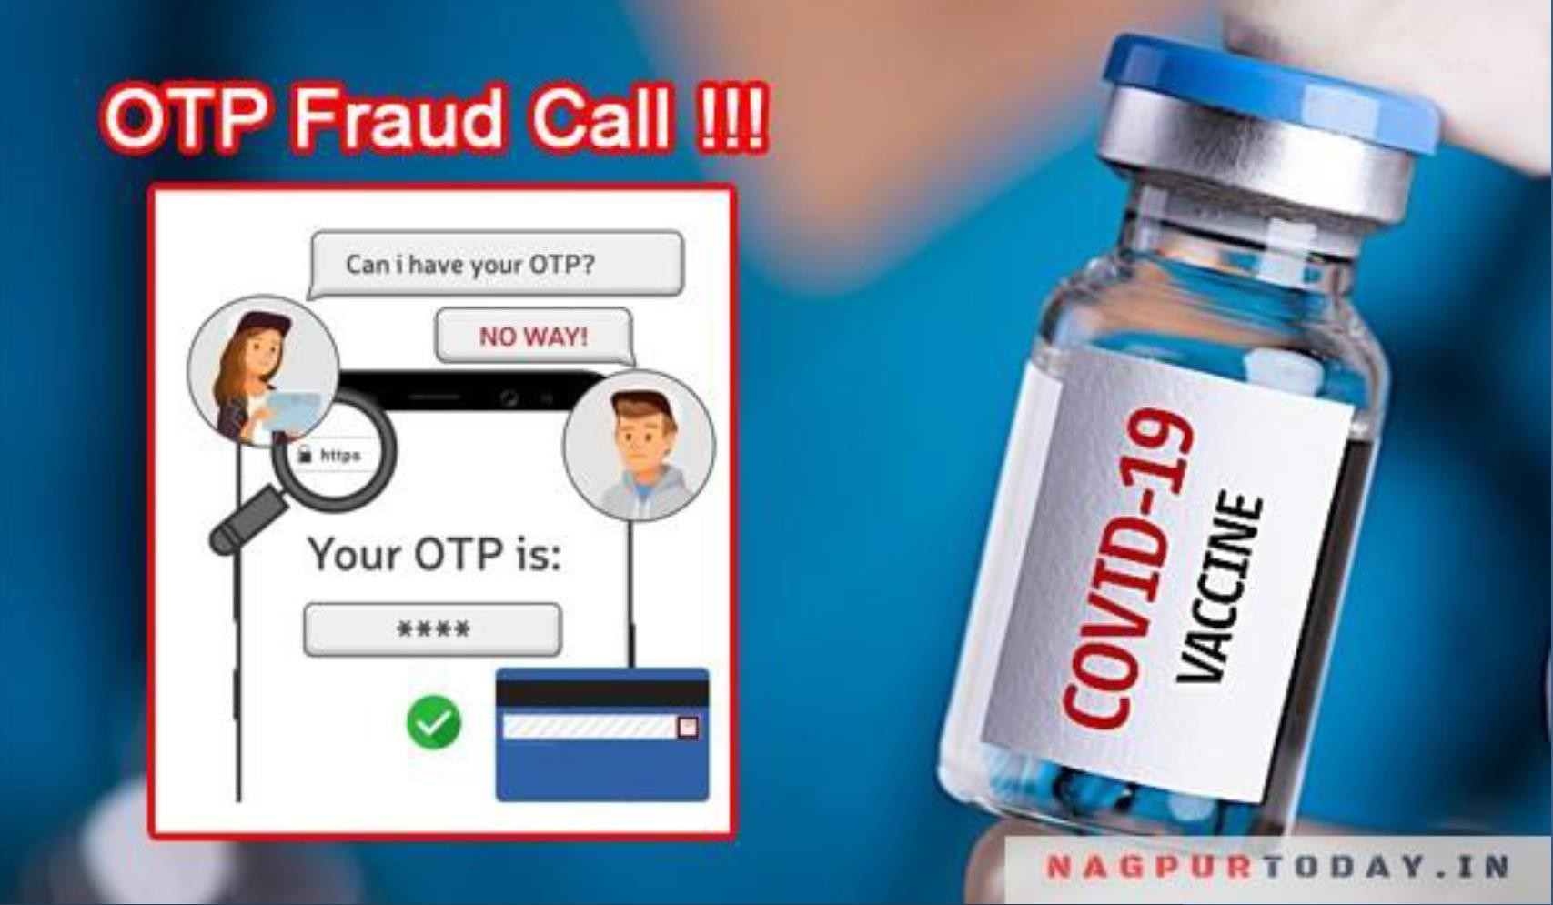
COVID-19 Cyber Threats

Slide 66
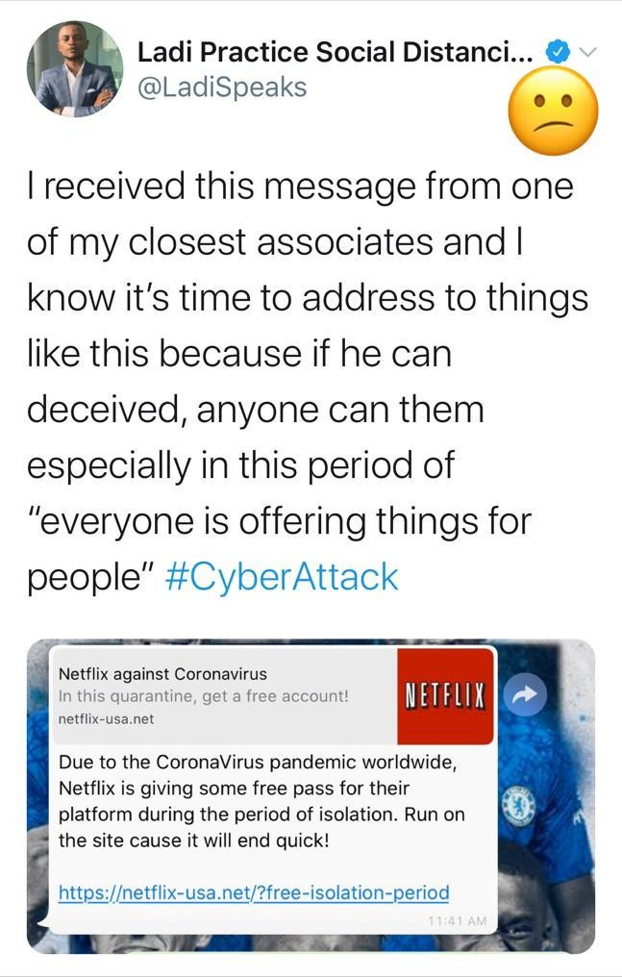
COVID-19 Cyber Threats

Slide 67
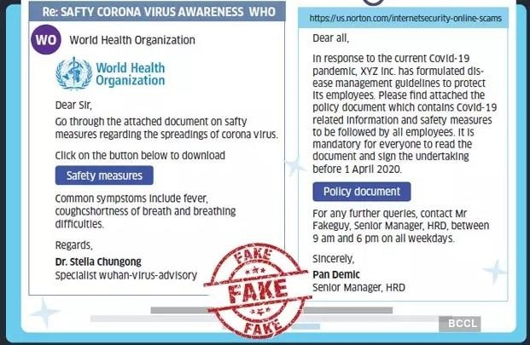
COVID-19 Cyber Threats

Slide 68
COVID-19 Cyber Threats
Google: 18+ Million COVID-19 emails in just the one week, in addition to 240M daily COVID-19 spam messages
Phishing up 667% right now
FBI IC3: 4x complaints per day (1K before COVID-19, now 3k-4k per day)
148% spike in ransomware attacks due to COVID-19
30%-40% increase in attacker interest relating to RDP (as measured by Shodan)
26% increase in e-comm web skimming in March
Healthcare, Financial Services, Medical Suppliers and Manufacturing, Government and Media Outlets all seeing a large increase in cyber threats

Slide 69
Storytime – Bank Wi-Fi: Password = admin123
In an audit at a public-sector bank, their guest Wi-Fi password was literally ‘admin123’. I was shocked. That’s not just poor hygiene — that’s a ticking bomb. It took one conversation to fix it, but it taught me that awareness is as critical as tools.

Slide 70
Cyber Crime
Cyber Crime is a generic term that refers to all criminal activities done using the medium of communication devices, computers, mobile phones, tablets etc. It can be categorized in three ways:
The computer as a target – attacking the computers of others.
The computer as a weapon- Using a computer to commit
“traditional crime” that we see in the physical world.
The computer as an accessory- Using a computer as a “fancy filing cabinet” to store illegal or stolen information.

Slide 71
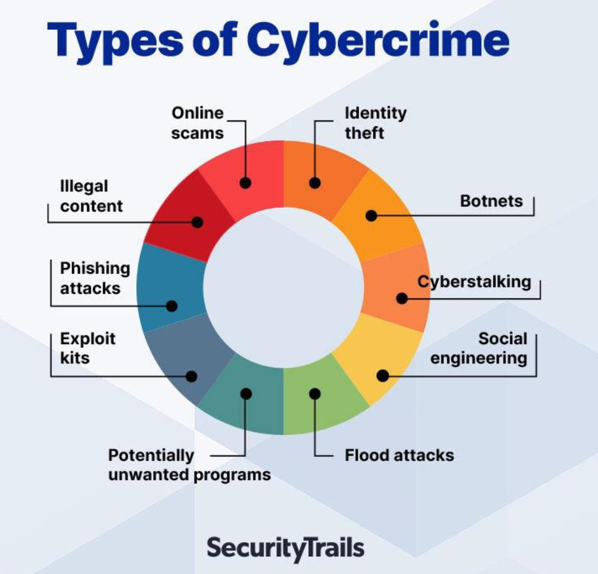

Slide 72


Slide 73
Guess the Hacker – Real or Fake?
Hacktivist. Insider. Script Kiddie. Sandesh Bhaiya? One is fake. But Sandesh was actually a student from this course who once found a critical vulnerability on an admin panel." ( *student name changed )

Slide 74

How do you look like to Bad guys?
66.233.160.64

Slide 75


Hacking
◆ Financial (theft, fraud, blackmail)
◆ Political/State (state level/military)
◆ Fame/Kudos (fun/status)
◆ Hacktivism (cause)
◆ Pen Testers (legal hacking)
◆ Police
◆ Insider
◆ Business

Slide 76

Which hat you want to wear?

Slide 77
What Kind of Hacker Will You Be?
Not everyone’s a red teamer. You might be a policy maker, a tool builder, or a bug bounty hunter. Let's find your cyber identity.

Slide 78
Group Debate – Hacking: Crime or Skill?
Team A = Hacking is a crime. Team B = Hacking is a skill.
Let’s get controversial — Is hacking always bad? Let’s hear both sides. This is how policymakers, educators, and hackers themselves shape narratives."

Slide 79

Ethical Hacking

Slide 80

System Hacking
System hacking is a vast subject that consists of hacking the different software-based technological systems such as laptops, desktops, etc.
System hacking is defined as the compromise of computer systems and software to access the target computer and steal or misuse their sensitive information.
Here the malicious hacker exploits the weaknesses in a computer system or network to gain unauthorized access to its data or take illegal advantage.
Hackers generally use viruses, malware,Trojans, worms, phishing techniques, email spamming, social engineering, exploit operating system vulnerabilities, or port vulnerabilities to access any victim's system.

Slide 81
Let’s Simulate Red vs Blue
Tomorrow, I’ll divide you into Red (attack) and Blue (defend) teams. It’s a fun simulation based on real-world penetration testing and defense scenarios.

Slide 82

Cybercrime as a Service

Slide 83

Web, Deep Web & Dark Web

Slide 84






Attacks today are AUTOMATED!
It’s not some person sitting at his hacker desk all day typing out ping commands to IP addresses via the command prompt manually…

Slide 85
Storytime – Student Bug Bounty in Week 2
One student of this course reported a reflected XSS vulnerability in an internal marks portal after our OWASP session. Got ₹4000 as bounty — in Week 2 itself! If you're curious and observant, opportunities come early.

Slide 86
BEC Best Practices
Avoid using free web-based email for business
Not only less-professional, but easier to hack, typosquat, or spoof
Domains and email addresses are cheap, especially compared to BEC (Business Email Compromise)
Register similar domains to yours to prevent typosquatting e.g. delaplex.com vs. delapelx.com
Be careful about the information you share on your website or Social Media (LinkedIn, Facebook) about job duties or positions, especially for positions with transactional or purchasing authority
◆ Think through Out of Office email responders

Slide 87

Sun Tzu on the Art of War
◆ If you know the enemy and know yourself, you need not fear the result of a hundred battles.
◆ If you know yourself but not the enemy, for every victory gained you will also suffer a defeat.
◆ If you know neither the enemy nor yourself, you will succumb in every battle.

Slide 88

WHAT IS FOOTPRINTING?
◆ Definition: the gathering of information about a potential system or network (the fine art of gathering target information)
◆ a.k.a. fingerprinting
◆ Attacker’s point of view
◆ Identify potential target systems
◆ Identify which types of attacks may be useful on target systems
◆ Defender’s point of view
◆ Know available tools
◆ May be able to tell if system is being footprinted, be more prepared for possible attack
◆ Vulnerability analysis: know what information you’re giving away, what weaknesses you have

Slide 89

WHAT IS FOOTPRINTING?
◆ System (Local or Remote)
◆ IP Address, Name and Domain
◆ Operating System
◆ Type (Windows, Linux, Solaris, Mac)
◆ Version (XP/Vista/7/10, Redhat, Fedora, SuSe, Ubuntu, OS X)
◆ Usernames (and their passwords)
◆ File structure
◆ Open Ports (what services/programs are running on the system)
◆ Networks / Enterprises
◆ System information for all hosts
◆ Network topology
Gateways
Firewalls
Overall topology
◆ Network traffic information
◆ Specialized servers
◆ Web, Database, FTP, Email, etc.
◆ Social Media

Slide 90

Vulnerability Scanner
◆ Functions of Vulnerability Scanner are far different from firewall or intrusion detection system.
◆ Vulnerability scanning tools helps you in protecting your organization from any kind of security risks or threats by scanning with deep inspection of endpoints to ensure that they are configured securely and correctly.
◆ The prime aim of running a vulnerability scanner is to identify the devices that are open for vulnerabilities.

Slide 91

Types of Vulnerability Scanner
◆ Port scanner
◆ Network vulnerability scanner
◆ Web application security scanner
◆ Database security scanner.
◆ Host based vulnerability scanner
◆ ERP security scanner.
◆ Single vulnerability tests.

Slide 92
Virus Detection
Simple Anti-virus Scanners
Look for signatures (fragments of known virus code)
Heuristics for recognizing code associated with viruses
Example: polymorphic viruses often use decryption loops
Integrity checking to detect file modifications
Keep track of file sizes, checksums, keyed HMACs of contents
Generic decryption and emulation
Emulate CPU execution for a few hundred instructions, recognize known virus body after it has been decrypted
Does not work very well against viruses with mutating bodies and viruses
not located near beginning of infected executable

Slide 93
Storytime – First Linux Install Took 3 Hours
My first Linux install wiped my Windows by mistake. Twice. It took 3 hours, several reboots, and a garam chai spill to get it running. But that pain taught me more than any tutorial ever did. You'll have your own story too — maybe less messy.

Slide 94
Cyber Security and Privacy Starts and Ends with Us!
Security Tips
Commit to a disciplined practice of information security and continue to refresh yourself so you don’t become a point of vulnerability in our security defenses.

Slide 95


Slide 96

Types of Security Tools

Slide 97


Slide 98


Slide 99


Slide 100


Slide 101


Slide 102


Slide 103

Wireshark

Slide 104


Slide 105


Slide 106

N-Map

Slide 107

Features

Slide 108


Slide 109

Nessus

Slide 110


Slide 111

Features

Slide 112


Slide 113


Slide 114


Slide 115

What does a Cyber Security Professional look like?

Slide 116








What does a Cyber Security Professional look like?

Slide 117






In reality…
David Ulevitch, Founder OpenDNS
Katie Moussouris, Microsoft Bug Bounty creator
Eugene Kaspersky, CEO Kaspersky Labs, £1.1bn
Dr Laura Toogood, MD Digitalis Reputation Erin Jacobs, CSO at UCB Financial Services
James Lyne, CTO, SANS

Slide 118


How We Protect Information?
◆ People
◆ Training, education, awareness, repetition
◆ Process
◆ Governance, oversight, policy, reporting
◆ Technology
◆ Firewalls, IDS/ISP, SIEM, anti-malware
◆ Strong passwords, Logging/monitoring
◆ Which is the weakest link?

Slide 119

Social Engineering Best Practices
◆ USE YOUR SECURITY SPIDER SENSE!
◆ ALWAYS validate requests for information if you’re not 100000% sure
◆ Call a number YOU know
◆ Google it…
◆ ALWAYS ASK QUESTIONS!
◆ Is this who I think it is FOR SURE?
◆ Did someone mention this to me personally, or was it discussed at a staff meeting?
◆ Is this the FIRST I’m hearing about this?

Slide 120

Summary
Cybersecurity will require a significant workforce with deep domain knowledge.
Almost everything is hooked up to the internet in some sort of form.
Recent events have widened the eyes of many security experts.
The ability to gain access to high security organizations, infrastructures or mainframes has frightened many people.
Could one click of the mouse start World War III?

Slide 121
Storytime – Bash Script Took Down Wi-Fi
Wrote a Bash script once to test network drops using ping in a loop — but forgot to rate-limit it. It started hammering dozens of IPs and brought down the internal Wi-Fi. That’s how I learned: testing is good, but control is better.

Slide 122
References
www.Wikipedia.org
www.avtest.org
www.billmullins.blogspot.com
www.digit/forum.com
www.antivirusnews.com

Slide 123
Today you’ve taken the first step — not toward just learning cybersecurity, but living it.
From Linux commands to firewalls, from OWASP to real-world case studies — we’re going to explore it all.
This training will give you:
• Hands-on experience in Linux environments
• Exposure to real cyber threats and tools
• Confidence to explore ethical hacking professionally
• Projects, quizzes, and guidance — every step of the way
Use the WhatsApp group for daily updates
All resources will be shared in Google Classroom
(https://classroom.google.com/c/NzgzOTAzMDAzMDM3?cjc=zo5s7knk)
Start reading: OWASP Top 10 | Fedora Setup Guide | Kali Linux Intro
And remember — I’m not just your trainer. I’m your guide. Let’s build this together.

Slide 124
Your First Challenge – Setup Fedora
Install Fedora in VirtualBox. Take a screenshot and share in the WhatsApp group. This is your entry ticket to the Linux lab world.

Slide 125
Mini Lab Teaser – Build a Phishing Page (On Google Colab)
Activity: Use a Google Colab notebook to simulate a phishing login form and observe how attackers might collect user inputs (safely and ethically).
Instead of risky software or outdated tools, we're using Google Colab — the safest way to simulate phishing concepts. This notebook lets students see how a fake login is created and how data is extracted — all without real storage or harm.
Demo Steps:
Open the Colab notebook (link below)
https://colab.research.google.com/drive/10j-94rM12kCOnFk-hnB_5_HBB_gYxBEH
Run the first cell to display a fake login form
Run the second cell to simulate data capture (widgets)

Slide 126


